Slide 1
CSE 4615:: Wireless Networks
IEEE 802.11 Wireless Local Area Networks
Lecture 6.1
Course Teacher:
Ashraful Alam Khan
Assistant Professor, CSE, IUT
Content Contributors:
Bernhard H. Walke
ComNets, RWTH Aachen University, Germany
Stefan Mangold
Swisscom Innovations, Switzerland
Lars Berlemann
ComNets, RWTH Aachen University, Germany

Slide 2



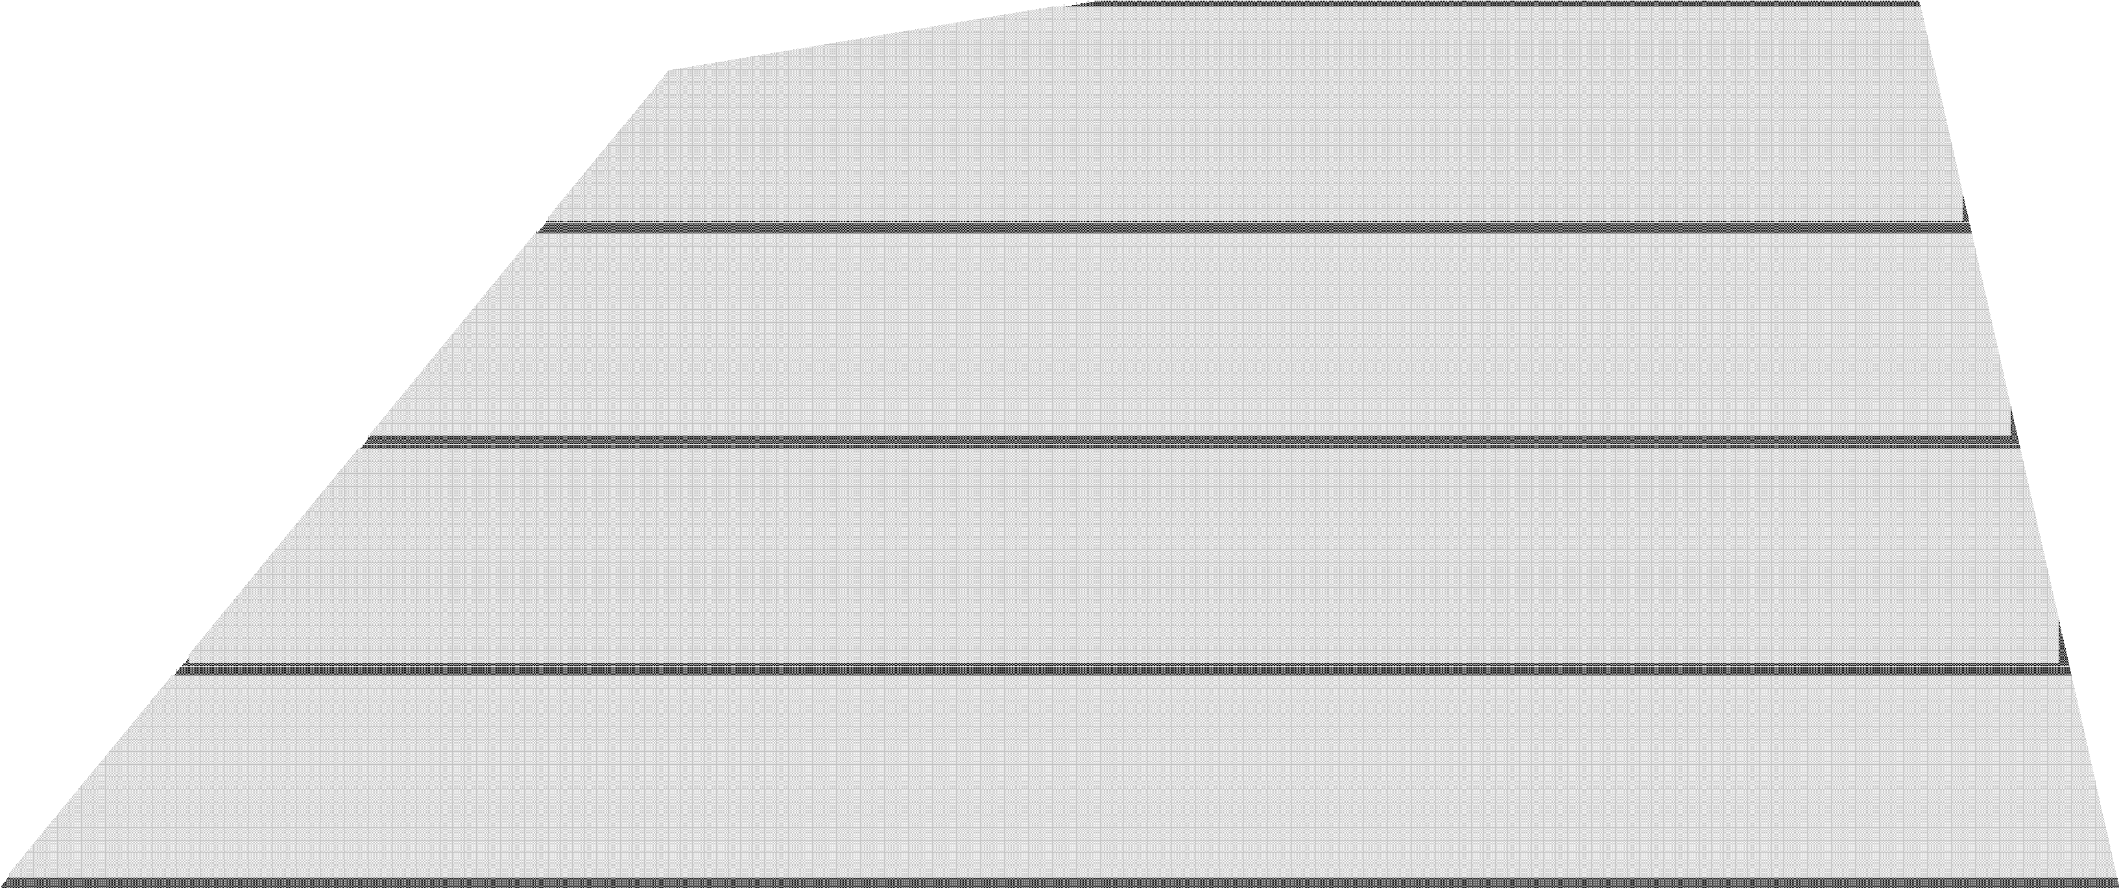
IEEE 802.11 Wireless Local Area Networks
Chapter 5, IEEE 802 Wireless Systems

Slide 3
Contents
Scope of 802.11
Reference Model, Architecture, Services, Frame Formats
Physical Layer
Medium Access Control Protocol
Medium Access Control with Support for Quality‐ of‐Service
Radio Spectrum Management
History and Selected Sub‐standards, i.e., Amendments

Slide 4


SCOPE OF 802.11

Slide 5
Scope of 802.11
802.11 standard focuses on the 2 lower layers (1 & 2) of the OSI reference model.
In the reference model of 802.11, Data Link Control (DLC) layer is divided into
Logical Link Control (LLC) and
Medium Access Control (MAC) sublayers.
802.11 defines Physical layer (PHY) transmission schemes and the MAC protocol, but no LLC functionality.

Slide 6
REFERENCE MODELS, ARCHITECTURE, SERVICES, FRAME FORMATS

Slide 7
Reference Model
It is an abstraction of the real‐life hardware and software modules of a radio standard, helping developers to discuss and understand the technology.

Slide 8
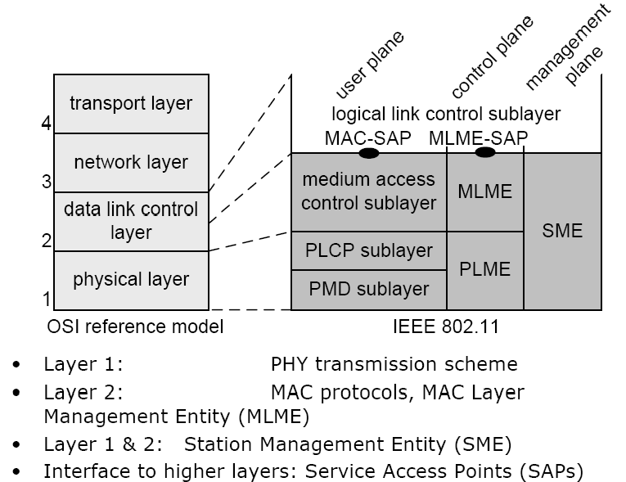
Reference Model

Slide 9
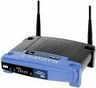









Architecture
802.11 Architecture & Coordination Functions
802.X LAN via portal
BSS
DS
BSS
Basic Service Set (BSS):
‐ The basic element of IEEE 802.11 Networks
‐ A group of stations controlled by so‐called Coordination Function (CF)
Coordination Function (CF):
‐ Manages the access to the wireless medium
IBSS

Slide 10
Architecture
Coordination Function (CF)
The Distributed CF (DCF) is used by all stations in the BSS,
whereas the Point CF (PCF) is an optional extension for the support of QoS.
DCF and PCF are concepts for spectrum management and medium access.
Independent Basic Service Set (IBSS)
The simplest 802.11 network type. Consists of a minimum of two stations
No station has priority over another.
The responsibility of coordinating the medium access is distributed among all stations

Slide 11
Architecture
An infrastructure‐based BSS includes 1 station that has access to the wired network (Access Point‐AP).
An ESS (Extended Service Set) consists of 1 or more BSSs connected over the Distribution System (DS).

Slide 12
Services
DS provides the service to transport MAC Service Data Units (MSDUs) between stations that are not in direct communication
An AP provides the Distribution System Service (DSS).
The DSSs enable the MAC to transport MSDUs between stations that are not in direct communication.
So DSSs are not available in an IBSS.
There are 2 categories of services in 802.11:
the Station Service (SS) and
the Distribution System Service (DSS).

Slide 13
Services
The main SS of a BSS is
the MAC Service Data Unit (MSDU) delivery.
Other SSs include (de)‐authentication and privacy.
DSSs include
(re‐)association, (dis)‐association, and integration.
The integration enables the delivery of MSDUs between non‐802.11 LANs and the DS via the so‐ called portal.

Slide 14
IEEE 802.11 Wireless LANs
802.11b
2.4-2.5 GHz unlicensed spectrum
up to 11 Mbps
802.11a
5-6 GHz range
up to 54 Mbps
OFDM
802.11g
2.4-2.5 GHz range
up to 54 Mbps
OFDM
802.11n: multiple antennae
2.4-2.5 and 5-6 GHz range
up to 600 Mbps
MIMO
Frame aggregation
Channel bonding
802.11ac
5-6 GHz range
up to 3.4 Gbps
MU-MIMO
all use CSMA/CA for multiple access

Slide 15
802.11 Frame Formats
(in these slides) the OFDM‐based 5GHz PHY layer 802.11a is used for description. The alternative PHYs use similar frame formats
In common, all PHYs consists of 2 sublayers:
PLCP
PMD
The PLCP maps the 802.11 MPDUs into PSDUs, a frame suitable for transmitting and receiving data, control and management information between the associated PMD entities.
The PMD determines the actual transmission scheme, i.e., the way of transmitting and receiving data through the wireless medium.
The frame that is finally transmitted over the channel is OFDM PLCP frame

Slide 16
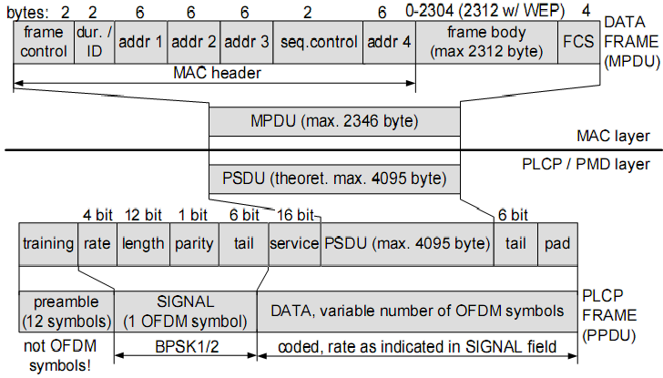
802.11 Frame Formats
Frame mapping from MAC down to PLCP

Slide 17
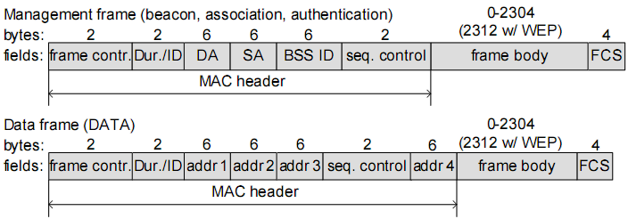
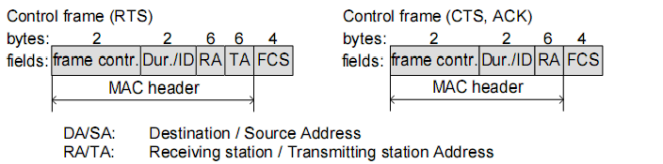
802.11 MAC Frames (MSDU)
There are 3 types of MPDUs: management, data, and control frames.
The frame body size of data and management frames are variable.

Slide 18
PHYSICAL LAYER

Slide 19
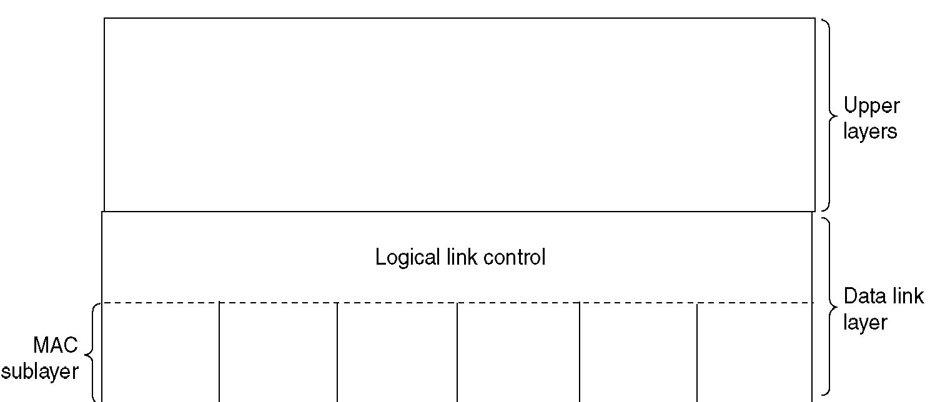
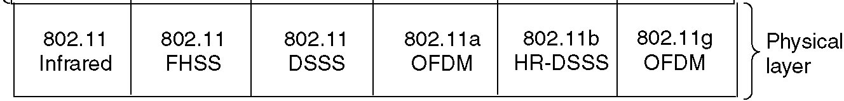
Physical Layer
At first, there was 3 different types of PHYs:
2.4 GHz Frequency Hopping Spread Spectrum (FHSS),
Direct Sequence Spread Spectrum (DSSS) and
Infrared (IR).
Four more PHYs are defined in supplement standards.

Slide 20
Physical Layer
FHSS is a method of transmitting radio signals by rapidly switching a carrier among many frequency channels, using a pseudorandom sequence known to both transmitter and
receiver.
In DSSS, all stations operate at the same center
frequency. Different spreading codes allow different sets of communicating stations to reduce the mutual interference.
IR physical layer so far has not been
commercially successful, but may be attractive
for future residential in‐house applications.

Slide 21
Physical Layer
High Rate Direct Sequence Spread Spectrum (HR/DSSS) transmission mode:
uses Complementary Code Keying (CCK). The code set is richer than the set of Walsh codes that are used in DSSS the higher data rate is achieved.
OFDM is the transmission scheme more and more used by wireless systems.

Slide 22
MEDIUM ACCESS CONTROL PROTOCOL

Slide 23
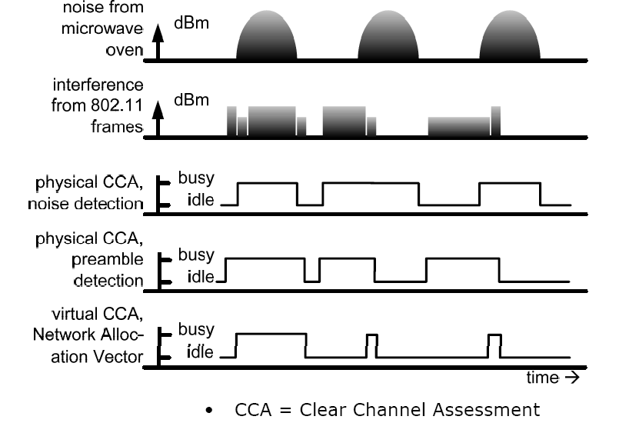
Listen Before Talk
After fully receiving the frame, the node can set NAV

Slide 24
Listen Before Talk
After fully receiving the frame, the node can set NAV

Slide 25
Listen Before Talk
After fully receiving the frame, the node can set NAV

Slide 26
Listen Before Talk
The channel sensing function is called Clear Channel Assessment (CCA).
It uses a power threshold (‐82dBm, possibly implementation dependent).
If a station detects a signal with power larger than this threshold, the radio channel is assumed to be busy
Otherwise the channel is idle.
There are different variants of CCA (see the previous Fig.)
Ordinary noise detection
Only signals from other 802.11

Slide 27
Listen Before Talk
The Network Allocation Vector (NAV) is an addition to the physical sensing of the radio channel.
It is referred to as virtual carrier sensing and in fact has the function of reserving the channel for some time.
It is a timer which decrements irrespectively of the status of the medium.
As long as the NAV is set or the CCA sensed the radio channel as being busy, a station is not allowed to initiate transmissions.

Slide 28
802.11 Medium Access Control Protocol
802.11 MAC protocol is built with the help of 2 coordination functions:
DCF for traffic without QoS (asynchronous services) and
PCF for traffic with QoS requirements (synchronous services).
In the following,
We discuss Distributed Coordination Function (DCF)
an infrastructure‐based BSS
The basic 802.11 MAC protocol is the DCF that works as a listen‐before‐talk scheme, based on the Carrier Sense Multiple Access (CSMA)

Slide 29
IEEE 802.11 Distributed Coordination Function (DCF)

Slide 30
Distributed Coordination Function (DCF)
802.11 DCF : based on the CSMA - sense before transmitting
No collision detection (CD)!
Difficult to receive (sense collisions) when transmitting due to weak received signals (fading)
Can’t sense all collisions in any case: hidden terminal, fading
Goal: avoid collisions: CSMA/C(ollision)A(voidance)
Link layer ACKnowledgments/Retransmissions (ARQ)
High bit error rates
A
B
C
C
A’s signal
strength
C’s signal
strength
B
A
space

Slide 31
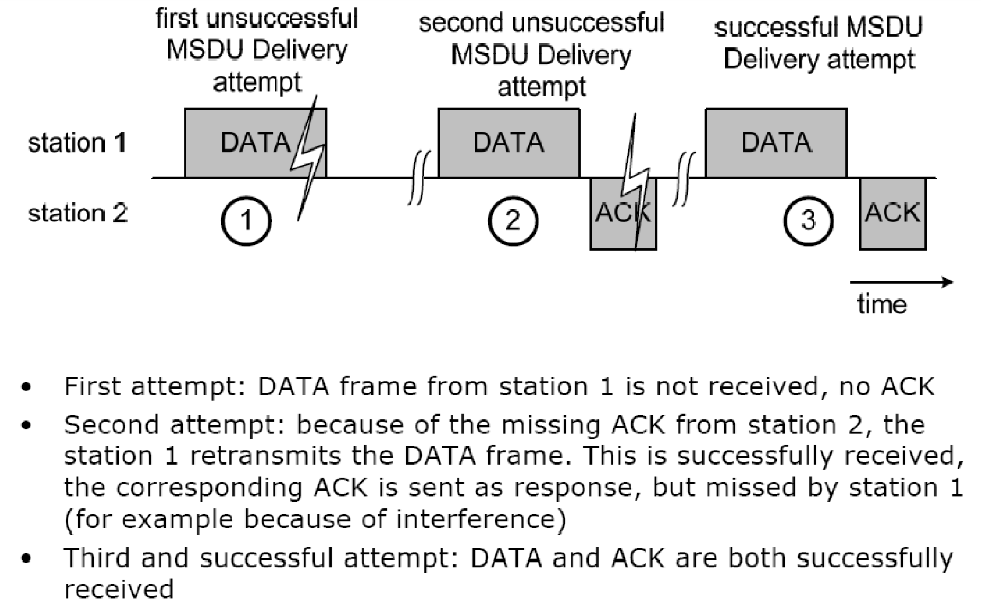
Timing and Interframe Spaces
Frame Exchange Scenarios

Slide 32
Timing and Interframe Spaces
Frame Exchange Scenarios

Slide 33
Timing and Interframe Spaces
Frame Exchange Scenarios

Slide 34
Timing and Interframe Spaces
The time between 2 MAC frames is called the Interframe Space (IFS).
802.11 defines 4 different IFSs:
Short Interframe Space (SIFS)
Point Coordination Function Interframe Space (PIFS)
Distributed Coordination Function Interframe Space (DIFS)
Extended Interframe Spce (EIFS)
These IFSs represent three different levels for medium access (See the Fig. in the following)
The shorter the IFS, the higher priority in medium access.
All interframe spaces are independent of the channel data rate.

Slide 35
Timing and Interframe Spaces
aSlotTime
is used to calculate the IFSs.
SIFS and aSlotTime are the basis of all other duration.
In 802.11a, aSlotTime=9µs
SIFS
is used to prioritize the immediate ACK of a data frame,
the response (CTS) to a RTS,
a subsequent MPDU of a fragmented MSDU,
response to any polling using the PCF, and
any frames of the AP during the CFP.
SIFS = 16µs for 802.11a
PIFS
used by stations operating under the PCF to obtain channel access with highest priority.
PIFS = SIFS + aSlotTime.
PIFS = 25µs for 802.11a
DIFS
used by stations operating under the DCF to obtain channel access.
DIFS = SIFS + 2 * aSlotTime
DIFS = 34µs for 802.11a

Slide 36
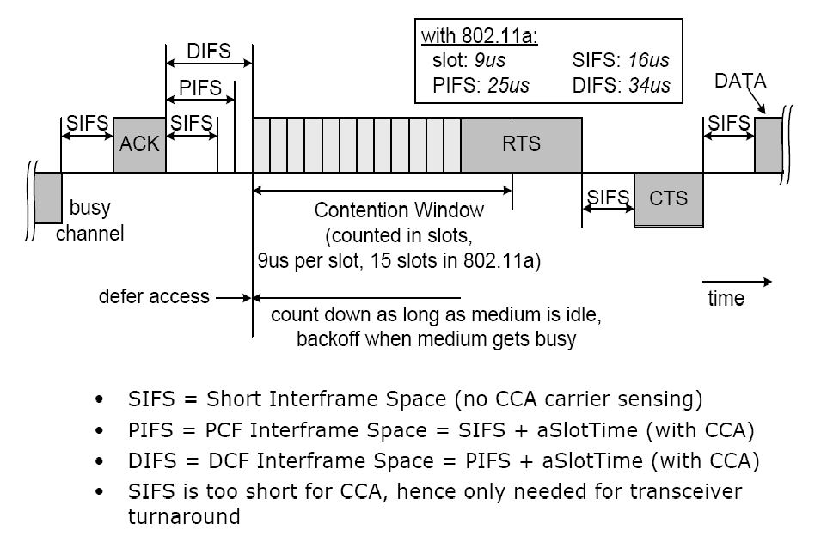
Timing and Interframe Spaces

Slide 37
Timing and Interframe Spaces

Slide 38
Timing and Interframe Spaces

Slide 39
Timing and Interframe Spaces

Slide 40
Timing and Interframe Spaces
EIFS (Extended IFS): used instead of DIFS when multiple stations initiated frame exchanges at different starting times, typically due to they are hidden from each other.
The EIFS results in a longer deferral from channel access, which gives other stations a higher priority in medium access.
As soon as 1 other frame is received correctly, DIFS is used again.
EIFS is around 200µs for 802.11a

Slide 41
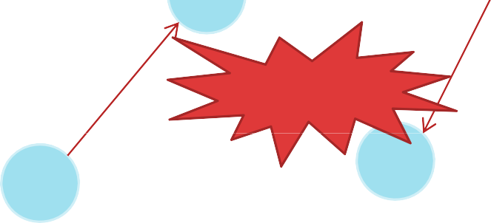
Collision Avoidance
A collision happens when there are more than 1 station attempts to transmit at the same time.
In wireless communication, transmitter cannot detect a collision at receiver while transmitting. To account for this,
802.11 is based on CSMA/CA.
C
B
Collision
A
D
Node A & C transmits at the same time

Slide 42
Collision Avoidance
If 2 or more stations detect the channel as being idle at the same time, inevitably a collision occurs when these stations initiate transmission at the same time.
802.11 defines a CA mechanism to reduce the probability of such collisions.

Slide 43
Collision Avoidance
As part of CA, a station performs the backoff procedure before starting a transmission.
A station having MSDU to deliver has to keep sensing the channel for an additional random time (=backoff) after detecting the channel as being idle for at least a DIFS (=34μs).
Duration of Backoff =
Random Backoff count,r x aSlotTime. (r=integer)
Each station maintains a so‐called Contention Window (CW), which is used to determine n.
CW = min( 2^{(n-1)} * CW_{min} - 1, CW_{max} )
Random Backoff count,r = Rand(0 ~ CW)
n= number of attempt
In IEEE 802.11a CW_{min} =16 , CW_{max} = 1024

Slide 44
Avoiding collisions (more)
idea: allow sender to “reserve” channel rather than random access of data frames: avoid collisions of long data frames
sender first transmits small request-to-send (RTS) packets to BS using CSMA
RTSs may still collide with each other (but they’re short)
BS broadcasts clear-to-send CTS in response to RTS
CTS heard by all nodes
sender transmits data frame
other stations defer transmissions
avoid data frame collisions completely
using small reservation packets!

Slide 45
Collision Avoidance: RTS-CTS exchange
A
AP
B
RTS(B)
RTS(A)
reservation collision
RTS(A)
CTS(A)
CTS(A)
DATA (A)
defer
time
ACK(A)
ACK(A)

Slide 46

Collision Avoidance
DIFS
PIFS SIFS
Random start
SIFS
SIFS
ACK
RTS
Data
CW = CWmin‐1 (=15
slots in 802.11a)
SIFS
CTS
Busy
channel
Defer
time
access
Count down as long as medium is idle, backoff when medium get busy
As part of CA, a station performs the backoff procedure before starting a transmission.
Ex: After a successful frame exchange, a station wants to send another data frame. It starts transmitting RTS after sensing the channel is idle for a duration equal to DIFS and its following backoff slots.

Slide 47
Collision Avoidance
DIFS
PIFS SIFS
Random start
SIFS
SIFS
ACK
RTS
Data
CW = CWmin‐1 (=15
slots in 802.11a)
SIFS
CTS
Busy
channel
Defer
time
access
Count down as long as medium is idle, backoff when medium get busy
As part of CA, a station performs the backoff procedure before starting a transmission.
Ex: After a successful frame exchange, a station wants to send another data frame. It starts transmitting RTS after sensing the channel is idle for a duration equal to DIFS and its following backoff slots.

Slide 48
Collision Avoidance
DIFS
PIFS SIFS
Random start
SIFS
SIFS
ACK
RTS
Data
CW = CWmin‐1 (=15
slots in 802.11a)
SIFS
CTS
Busy
channel
Defer
time
access
Count down as long as medium is idle, backoff when medium get busy
As part of CA, a station performs the backoff procedure before starting a transmission.
Ex: After a successful frame exchange, a station wants to send another data frame. It starts transmitting RTS after sensing the channel is idle for a duration equal to DIFS and its following backoff slots.

Slide 49
Collision Avoidance
DIFS
PIFS SIFS
Random start
SIFS
SIFS
ACK
RTS
Data
CW = CWmin‐1 (=15
slots in 802.11a)
SIFS
CTS
Busy
channel
Defer
time
access
Count down as long as medium is idle, backoff when medium get busy
As part of CA, a station performs the backoff procedure before starting a transmission.
Ex: After a successful frame exchange, a station wants to send another data frame. It starts transmitting RTS after sensing the channel is idle for a duration equal to DIFS and its following backoff slots.

Slide 50






Collision Avoidance
After an unsuccessful transmission, the next
DIFS
Random start
₁st
Busy
Frame
backoff is performed with a doubled size of
CW = Cwmin ‐ 1 (=15 in 802.11a)
Random start
the contention window. This reduces the collision probability if there are multiple stations attempting to access the
DIFS
_{n}st
Busy
Repeated frame
CW = 2^{n‐1}.Cwmin ‐ 1
channel.

Slide 51
Collision Avoidance
After an unsuccessful transmission, the next
DIFS
Random start
₁st
Busy
Frame
backoff is performed with a doubled size of
CW = Cwmin ‐ 1 (=15 in 802.11a)
Random start
the contention window. This reduces the collision probability if there are multiple stations attempting to access the
DIFS
_{n}st
Busy
Repeated frame
CW = 2^{n‐1}.Cwmin ‐ 1
channel.

Slide 52
Collision Avoidance
The station that deferred from channel access during the channel busy period do not select a new random backoff time, but continue to count down the time of previous backoff after sensing the channel as idle again.
In this way, stations, which deferred from medium access because their random backoff was larger than other’s, are given a higher priority when they resume the transmission attempt.

Slide 53
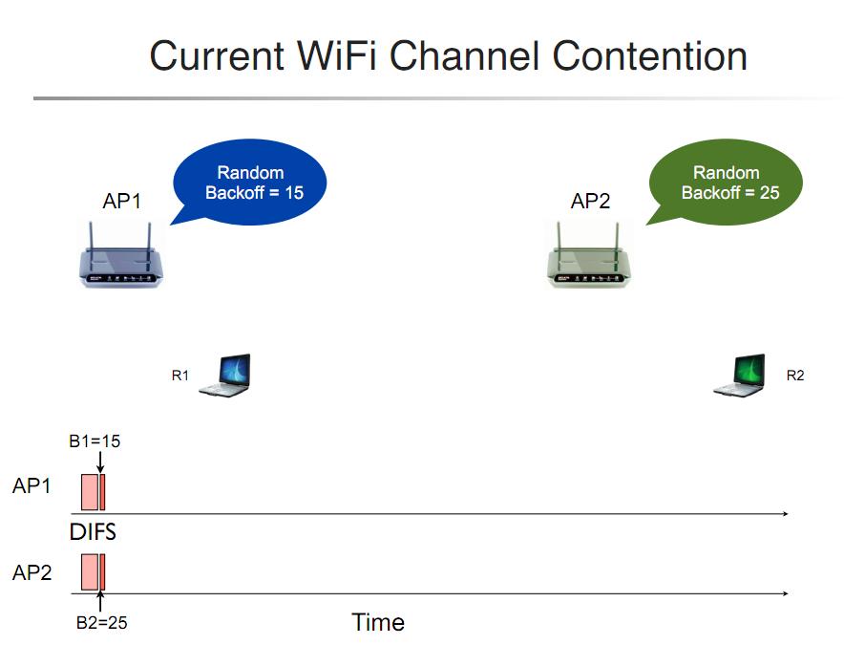
802.11 Backoff Example

Slide 54
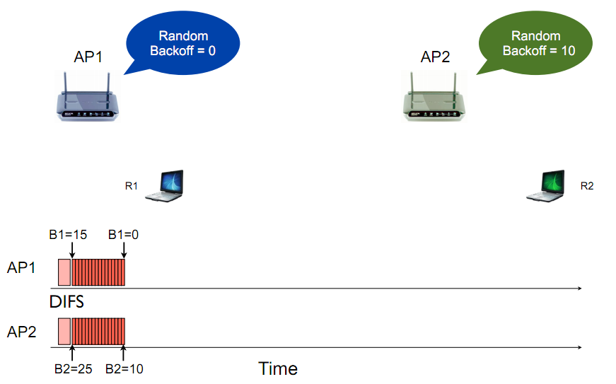
802.11 Backoff Example
After 15 slot countdown

Slide 55
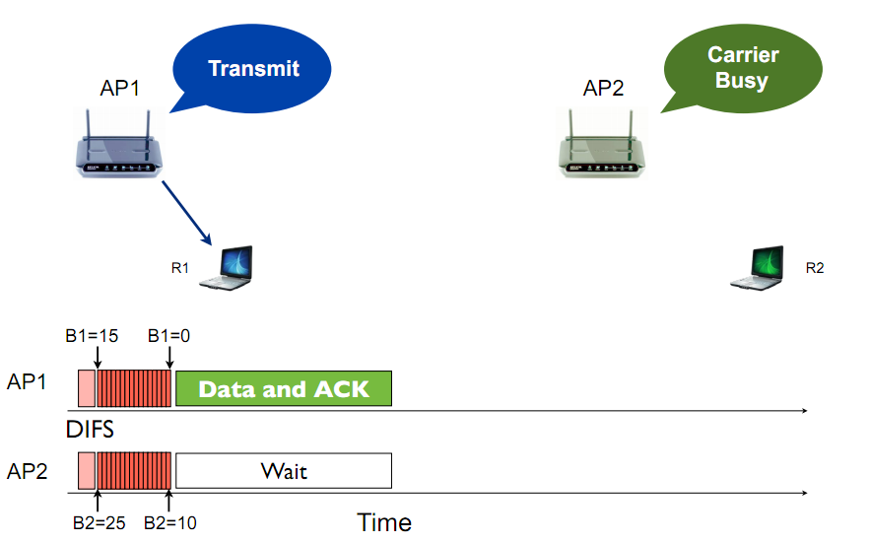
802.11 Backoff Example
RTS, CTS Disabled Scenario !

Slide 56
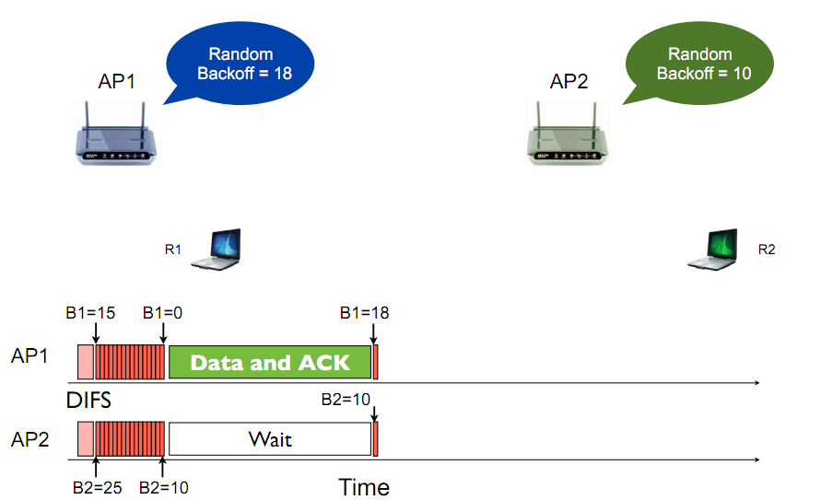
802.11 Backoff Example
RTS, CTS Disabled Scenario !

Slide 57
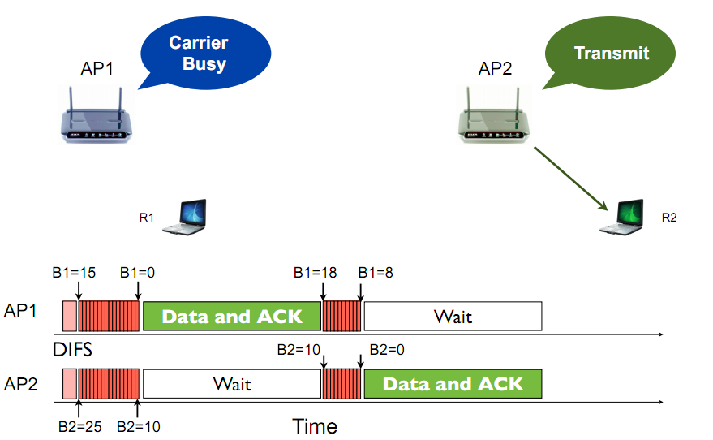
802.11 Backoff Example
RTS, CTS Disabled Scenario !

Slide 58
Distributed Coordination Function (DCF)
sender
receiver
802.11 sender
1.1 if sense channel busy then freezes
1.2 if sense channel idle for DIFS then
2.1 start random backoff time
timer counts down while channel idle,
freezes when busy,
resumes if idle for DIFS
transmit RTS when timer expires (why?)
3. if no CTS, then go to 1.2 (why?)
4. if CTS, then wait SIFS, and transmit DATA
5. if no ACK, increase random backoff interval, go to 1.2 (why?)
802.11 receiver
if RTS frame received OK
return CTS after SIFS
if Data frame received OK
return ACK after SIFS (ACK needed due to hidden terminal problem)
DIFS
e.g, 5
4
3
2
1
0
Random Backoff
RTS
SIFS
CTS
SIFS
data
SIFS
ACK
ACK
Notes:
Does it always avoid collisions? How to do rate adaptation?

Slide 59
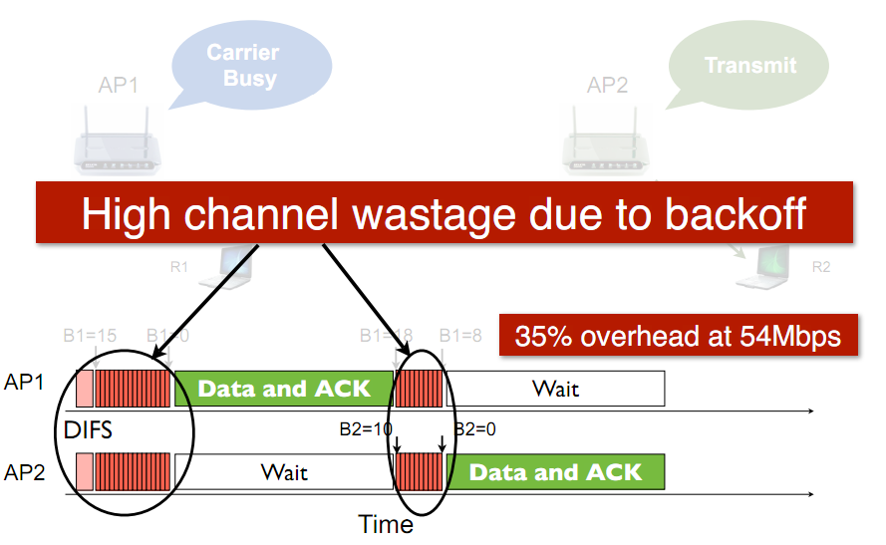
802.11 Medium Access Overhead

Slide 60
802.11 Medium Access Overhead
Transmitter
Receiver
Overhead:
DIFS
Random backoff
ACK/SIFS
Optional RTS/CTS handshake before transmission of data packet (often disabled due to its overhead)
Header overhead
802.11 has room for improvement. How?
(Will be discussed in coming lectures)
DIFS
Random
Backoff
RTS
Data Transmission
SIFS
CTS
SIFS
ACK

Slide 61
802.11 Medium Access Overhead
Collision

Slide 62
802.11 Medium Access Overhead
Significant Inefficiencies of 802.11 DCF :
Idle Channel Time: During the countdown, the channel remains idle, even though no transmission occurs. This results in underutilization of available bandwidth.
Collision Probability: When two or more nodes pick the same backoff value, simultaneous transmission leads to packet collisions. These collisions cause retransmissions and an exponential increase in CW, further delaying future transmissions.
Exponential Backoff Under Congestion: In IEEE 802.11, Binary Exponential Backoff (BEB) increases CW size as:
CW = min(2^n * CWmin - 1, Cwmax)
for each failed attempt (up to CWmax = 1024).
At 10 active nodes, probability of at least two nodes choosing the same slot exceeds 40%, drastically reducing throughput and increasing latency.

Slide 63
802.11 Medium Access Overhead
Collision
High channel wastage due to exponential backoff
Check for More Details: Lecture-6.2 Inefficiency of Random Access based Multiple Access Protocol.pdf

Slide 64
Recovery Procedure and Retransmissions
When a frame exchange is not successful, the size of the frame is compared against a threshold value before retransmission
If Size < threshold, or the frame was RTS
increment SRC (Short Retry Counter);
else increment LRC (Long Retry Counter).
The frame is discarded when SRC or LRC reaches a limit (default: SRC limit = 7, LRC limit = 4)
Whenever an MSDU is successfully transmitted, SRC and LRC are reset.
The threshold is implementation dependent

Slide 65
Post‐backoff
After each successful transmission, it is mandatory that another random backoff is performed even if there is no other MSDU to be delivered at the station. This is referred to as post‐backoff because it is performed after, not before, a transmission.
It is guaranteed that any frame will be delivered with backoff.
An MSDU arriving at the station from the higher layer may be transmitted immediately without waiting any time, if the transmission queue is empty, the latest post‐backoff has been finished, and at the same time, the channel has been idle for a minimum duration of DIFS.
This helps to reduce the delivery delay in lightly loaded systems.

Slide 66
Fragmentation
The process of partitioning an MSDU into smaller MPDUs when its length exceeds a fragmentation threshold.
The benefit of fragmentation is that in the case of failed transmission, the error is detected earlier and there is less data to retransmit.
It also increases the probability of successful transmission of the MSDU in scenarios where the radio channel characteristics cause higher error probabilities for longer frames than for shorter ones.
The obvious drawback is the increased overhead.

Slide 67
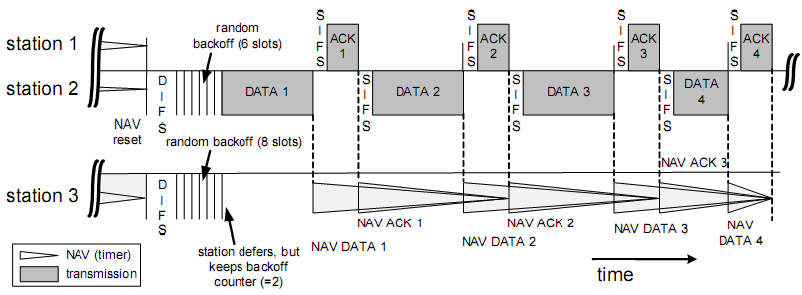
Fragmentation
The process of recombining MPDUs into a single MSDU is called defragmentation.
Only MPDUs with a unicast receiver address may be fragmented.
Note: The maximum length of an MSDU is limited to 2346 byte.

Slide 68
Hidden Stations and RTS/CTS
Hidden Stations problem arises when a station is able to successfully receive frames from two different stations but the two stations cannot detect each other.
To reduce throughput reduction owing to this problem, 802.11 specifies exchange of Request‐to‐ Send/Clear‐to‐Send (RTS/CTS) frames as an option made by transmitting station.
Consecutive frames in the sequence of RTS, CTS, data and ACK are spaced by an SIFS duration for transceiver turn‐around.

Slide 69
Hidden Stations and RTS/CTS
The RTS/CTS carry in its duration fields the information, how long the sequence RTS, CTS, Data, ACK will take.
Hence, other stations close to the transmitting station and hidden stations close to the receiving station will not start any transmissions; their NAV timer is set.
A hidden station close to receiving station might not receive the RTS due to the large distance, but will in most cases receive the CTS frame

Slide 70
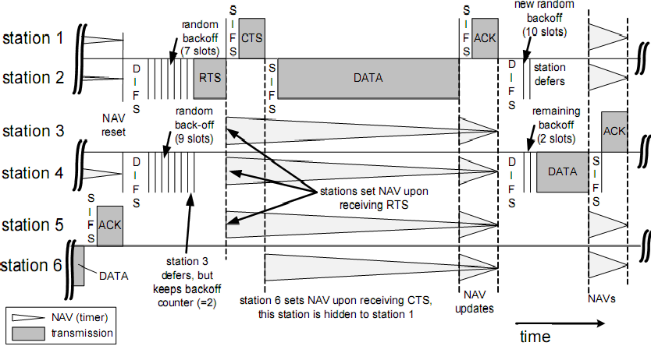
Hidden Stations and RTS/CTS
Station 6 cannot detect the RTS from station 2, but can hear the CTS of station 1. Although station 6 is hidden to station 2, it refrains from channel access because of NAV.
Note that SIFS is shorter than DIFS, which always gives CTS and ACK the highest priority for access to the channel

Slide 71
Synchronization and Cell Search
All stations within a single BSS are synchronized to a common clock via the Timing Synchronization Function (TSF).
To synchronize the stations, a management frame, the beacon, is used.
The time when the next beacon frame arrive is called Target Beacon Transmission Time (TBTT). The beacons are transmitted periodically.

Slide 72
Synchronization and Cell Search
TSF’s function
Support various PHY’s that require synchronization
Management function such as joining a BSS and saving power through sleep modes

Slide 73
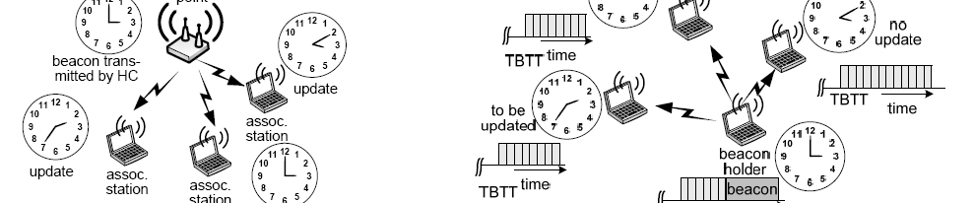
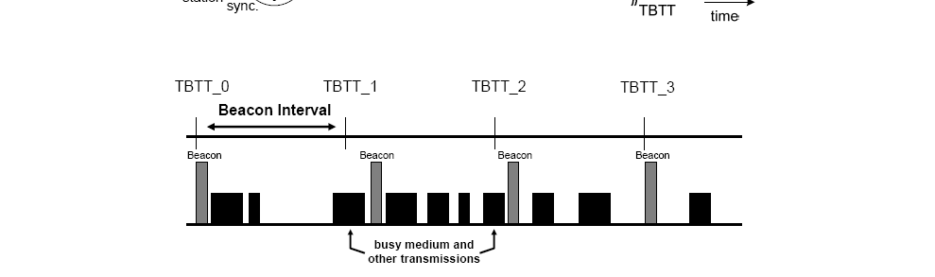
Synchronization and Cell Search
BSS
IBSS

Slide 74
Synchronization and Cell Search
BSS
IBSS

Slide 75
Synchronization and Cell Search
In BSS and IBSS, the synchronization is maintained by broadcasting the TSF timer in the beacon.
In (infrastructure) BSS, only the AP generates beacons.
If the channel has been idle for at least PIFS before TBTT, the AP transmits the beacon at TBTT, otherwise the beacon is transmitted PIFS after the current transmission.
All stations associated to this AP update their local timers.

Slide 76
Synchronization and Cell Search
In IBSS, the TSF is distributed over all stations. They all take part in the generation of beacons. The beacon generation is distributed using a mechanism similar to the backoff mechanism.
Stations stop attempting to transmit a beacon when they receive a beacon from another station of the IBSS. However, beacons transmitted in contention may collide. Collided beacon is not retransmitted.
Station updates its local timer only if the received value in beacon earlier then its current value.
This distributed synchronization function results in the fact that the complete IBSS will synchronize to the fastest running clock.

Slide 77
Synchronization and Cell Search
The beacon delivers other parameters related to the protocol
and radio regulations: for example
Basic Service Set Identification (BSSID),
Beacon Interval (BI),
PHY depending parameters,
duration of the CFP,
available channels,
power limits, etc.
Depending on the type of BSS, not all information may be contained in the beacon.
In infrastructure BSS, the AP uses the beacon for instructions to its associated stations and announcements of future transmissions.
Knowledge about TBTT allows associated stations to operate in power save mode.
Traffic indication messages conveyed together with each beacon
inform particular stations an buffered MSDUs and an upcoming multicast/broadcast messages.

Slide 78
Scanning Procedures in WLAN 802.11
IEEE 802.11 defines two scanning modes:
Passive
Active
The decision on which scanning mode is to be applied is taken by the Station Management Entity (SME).
The SME is a layer‐independent entity that may be viewed as residing in a separate management plane.
The exact functions of the SME are not specified in the standard.
The SME executes actions related to general system management. It directs the MLME to perform either passive or active scanning.

Slide 79
Scanning Procedures in WLAN 802.11
host must associate with an AP
scans channels, listening for beacon frames containing AP’s name (SSID) and MAC address
selects AP to associate with
may perform authentication
will typically run DHCP to get IP address in AP’s subnet

Slide 80
802.11: passive/active scanning
BBS 1
BBS 2
BBS 1
BBS 2
AP 1
1
AP 2
AP 1
1
AP 2
1
2
2
2
3
3
4
H1
H1
Passive Scanning:
beacon frames sent from APs
association Request frame sent: H1 to selected AP
association Response frame sent: H1 to selected AP
Active Scanning:
Probe Request frame broadcast from H1
Probes response frame sent from APs
Association Request frame sent: H1 to selected AP
Association Response frame sent: H1 to selected AP

Slide 81
802.11: passive/active scanning
BBS 1
BBS 2
BBS 1
BBS 2
AP 1
1
AP 2
AP 1
1
AP 2
1
2
2
2
3
3
4
H1
H1
Passive Scanning:
beacon frames sent from APs
association Request frame sent: H1 to selected AP
association Response frame sent: H1 to selected AP
Active Scanning:
Probe Request frame broadcast from H1
Probes response frame sent from APs
Association Request frame sent: H1 to selected AP
Association Response frame sent: H1 to selected AP

Slide 82
Passive Scanning
A station monitors each specified channel for a time span of at most MaxChannelTime.
During the scanning, the station adds any received
802.11 beacon or probe response to its cached BSSID scan list.
The scanning duration may vary, depending on the # of channels to be scanned, the BI, and the load of the system.

Slide 83
Active Scanning
A station needs to generate specific request messages, so‐called probe frames, then waiting for probe response. The probe response need to be acknowledged to ensure integrity of data delivery.
The probe mechanism forces an AP to convey basically the same system information as done with the periodic beacon signal without unnecessary waiting times.

Slide 84
MEDIUM ACCESS CONTROL WITH SUPPORT FOR QUALITY‐OF‐ SERVICE

Slide 85
IEEE 802.11 Point Coordination Function (PCF)

Slide 86
Medium Access Control with Support for Quality‐of‐Service
IEEE 802.11 defines the Point Coordination Function (PCF) to let station have priority access to the radio channel, coordinated by a station called Point Coordinator (PC).
PC typically resides in the AP.
The PCF has higher priority than the DCF, because the period during which the PCF is used is protected from the DCF access by the NAV.

Slide 87

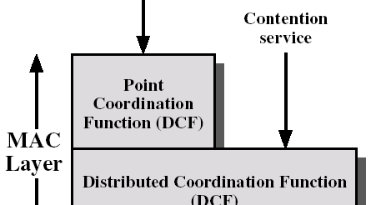
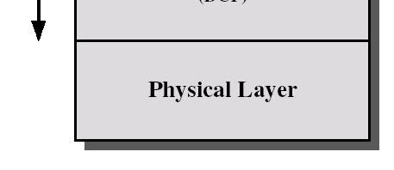
Medium Access Control with Support for
Quality‐of‐Service
The time during which
802.11 stations operate is divided into repeated periods, called superframes. It starts with a beacon, includes
Contention Free Period (CFP),
Contention period (CP).
During the CFP, the PCF is used for accessing the channel, while the DCF is used during the CP.
(PCF
)
Dependent on network standard choice

Slide 88

Point Coordination Function
P
S
S
S
S
Sta.1 (PC)
I F S
beacon
I F S
Data + CF‐Poll
I F S
Data + CF‐Poll
I F S
I F S
CF‐end
Sta.2
CFP TBTT
Data + CF‐Ack
S I F S
CF‐Ack
CP
CP
S I
Sta.3 sets NAV at TBTT, update after beacon reception
Sta.3
^{F} Ack
NAV
reset
S
Sta.4
DCF data transmission during CP
Sta.4 is hidden to the PC, it does not set its NAV. This station should not be part of the BSS coordinated by the PC (sta.1)
time
TBTT
P I F S
S I F S
P I F S
S I F S
S I F S
Sta.1 (PC)
beacon
CF‐Poll
CF‐Poll
CF‐Poll
CF‐end
Sta.2
Data
S
Ack
S
Data + CF‐Ack
^{S} Data +
(MSDU)
I F
No response to poll, recover after PIFS
I F
I F
CF‐Ack
S
S
S
CP
CP
CFP
Start of CFP is delayed
Duration of data frame is unknown to the PC

Slide 89
Point Coordination Function
This previous figure is an example for the PCF operation. Station 1 is the PC and polls station 2.
Station 3 detects the beacon frame and updates the NAV for the whole CFP.
CFP may be delayed (lower part of the figure).
PC has data pending for station 2
combine data and poll frame into the data frame.
The PC continues polling other stations until the CFP expires. No idle period longer than PIFS occurs during CFP.
A CF‐End control frame is transmitted to signal the end of the CFP.

Slide 90
QoS Support with PCF
The time the beacon is delayed from TBTT determines the delay of the transmission of time‐ bounded MSDUs that have to be delivered in the CFP.
The duration of the MSDU delivery after polling is not under the control of the PC, which reduces the QoS provided to other stations that are polled during the rest of the CFP.

Slide 91
QoS Support Mechanisms of 802.11E

Slide 92
QoS Support Mechanisms of 802.11E
The 802.11e extension introduces the Hybrid Coordination Function (HCF) for QoS support.
The HCF defines 2 medium access mechanisms:
(i) the contention‐based channel access (referred to as Enhanced Distributed Channel Access‐EDCA);
(ii) the controlled channel access, which includes polling (HCF Controlled Channel Access‐HCCA).
With 802.11e, there may still be the 2 phases of operation within a superframe:
Contention period (CP)
Contention Free Period (CFP)
EDCA is used only in CP, while HCCA is used in both phases.

Slide 93












QoS Support Mechanisms of 802.11E
Main elements of 802.11e MAC
Contention free services for non‐ QoS STAs otherwise
Required for time bounded sevices with
Required for time
optional
QoS guarantee
prioritiezed QoS services
architecture in the context of 802.11.
Hybrid Coordination Function (HCF)
Used for
contention‐ based services; basis for PCF & HCF
Point Coordination Function (PCF)
HCF
controlled access
HCF
contention‐ based access
DCF is the basis for the contention‐based
(HCCA) (EDCA)
Distributed Coordination Function (DCF)
access of the HCF and PCF.

Slide 94
QoS Support Mechanisms of 802.11E
Concepts:
QBSS: a QoS supporting BSS, including an 802.11e‐compliant HC.
HC (Hybrid Coordinator): the station that operates as the central coordinator for other stations, similar to PC in BSS.
There are multiple backoff processes operating in parallel
. ,
.
(Therefore, in the following we’ll refer to backoff entities that attempt to deliver MSDUs, instead of stations)

Slide 95
Improvements of the Legacy
802.11 MAC
A TXOP (transmission opportunity) is an interval of time, during which a backoff entity has the right to deliver MSDUs, is defined by its starting time and duration.
TXOPs, which are obtained via the contention‐based medium access, are referred to as EDCA‐TXOPs, and limited by TXOPlimit
HCCA‐TXOPs (or polled TXOPs) are obtained by the HC via the controlled medium access, and protected by NAV.
A time period in which the HC has control over the wireless medium is called Controlled Access Phase (CAP)

Slide 96
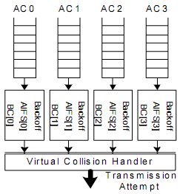
Contention‐based Medium Access
There are four Access Categories (AC), thus, four backoff entities exist in every 802.11e stations.
ACs are labeled according to their target application: AC_VO (voice), AC_VI (video), AC_BE (best effort), AC_BK (background).
Each backoff entity within a station independently contends for a TXOP.

Slide 97
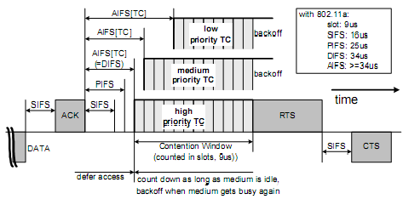
Contention‐based Medium Access
After detecting the medium being idle for a duration of AIFS[AC] (Arbitration Interframe Space), backoff entity start down‐counting. AIFS is calculated as follow:
AIFS[AC] = SIFS + AIFSN[AC]∙aSlotTime >= 2
Min and Max of the contention window are the other parameters dependent on AC.

Slide 98
Contention‐based Medium Access
The size of the CW in backoff stage i, after i‐1 times unsuccessful transmission is:
CWi[AC] = min[2^{i}(CWmin[AC]+1)‐1,CWmax[AC]]
The collision probability increases with smaller CWmin[AC] if there are more than 1 backoff entity of the respective AC operating in the QBSS.
The smaller CWmax[AC], the higher the medium access priority. However, a small CWmax[AC] may increase the collision probability.
Besides retry counters similar to legacy 802.11, 802.11e also defines a maximum MSDU lifetime per AC to allow a frame remain in MAC.

Slide 99
Contention‐based Medium Access
Once a TXOP is obtained, a backoff entity may continue to deliver more than 1 MSDU consecutively during the same TXOP, which may take up to TXOPlimit[AC]. This concept is referred to as continuation of an EDCF‐TXOP.
Each AC has: QSRC[AC], QLRC[AC] (short and long retry counters). They are used for MAC frames of different lengths. Their default values are not given.
When more than 1 entities in the same station reach 0 at the same time, a virtual collision occurs.
The backoff entity with higher priority will transmit, whereas the others act as if a real collision occurred on the medium.

Slide 100
Controlled Medium Access
The controlled medium access of the HCF, referred to as HCCA extends the EDCA access rules by allowing the highest medium access to the HC during both CFP and CP.
HC may allocate TXOPs to itself to initiate MSDU deliveries whenever required, after detecting the medium idle for PIFS duration and without backoff.
To give HC higher priority over legacy DCF and EDCA, AIFSN[AC] must be selected such that the earliest medium access for EDCA is DIFS for any AC.
QoS CF‐Poll from HC can be transmitted after a PIFS idle period, without backoff.

Slide 101
Controlled Medium Access
During CFP, 802.11e backoff entities will not attempt to access the medium without being explicitly polled, hence, only HC can allocate TXOPs by transmitting QoS CF‐Poll.
During a polled TXOP, a polled station can transmit multiple frames, with SIFS between 2 consecutive frames as long as the entire exchange duration does not exceed TXOPlimit.

Slide 102
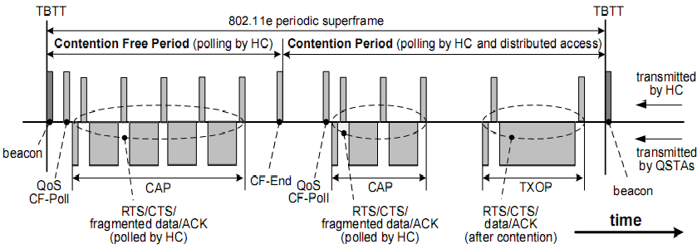
IEEE 802.11e Superframe
The superframe starts with a beacon transmitted by HC.
During CFP, the backoff entites only transmit upon being polled by HC.
During the CP, HC may poll a station, which is different from PCF of the legacy 802.11

Slide 103
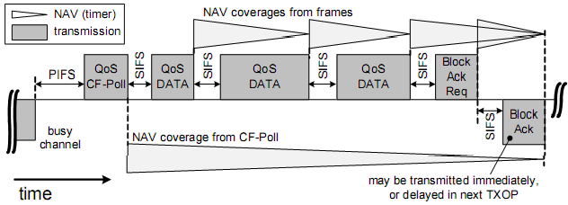
Block Acknowledgment
Block acknowledgments allow a backoff entity to deliver a number of MSDUs being delivered consecutively during one TXOP and transmitted without individual ACK. € Throughput efficiency is improved.

Slide 104
Direct Link Protocol (DLP) for IEEE 802.11 WLAN

Slide 105
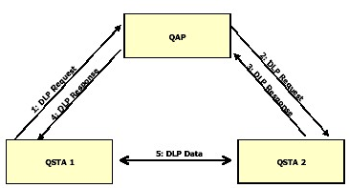
Direct Link Protocol (DLP)
In the legacy 802.11, within an infrastructure‐based BSS, AP relays all the frames. This wastes the channel capacity compared to the direct
.
The direct communication in 802.11e is referred to as Direct Link (DiL).
A set up procedure, the Direct Link Protocol (DLP) is defined to establish a DiL between 802.11e backoff entities.
Overview of DLP for setting up a direct link

Slide 106
802.11 Unicast vs. Broadcast
802.11 Unicast
802.11 Broadcast
RTS/CTS
ACK/Re-tx
Exponential backoff
Auto-rate adaptation
No RTS/CTS
No ACK/Re-tx
No exponential backoff
Single (low) rate

Slide 107
RADIO SPECTRUM MANAGEMENT

Slide 108
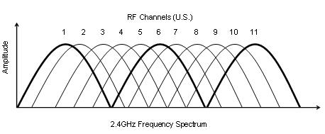
802.11: Channels
802.11b/g: 2.4GHz-2.485GHz spectrum divided into 11 channels at different frequencies
AP admin chooses frequency for AP
interference possible: channel can be same as that chosen by neighboring AP!
802.11a: 8 non-overlapping channels
Only 3 non-overlapping channels!

Slide 109
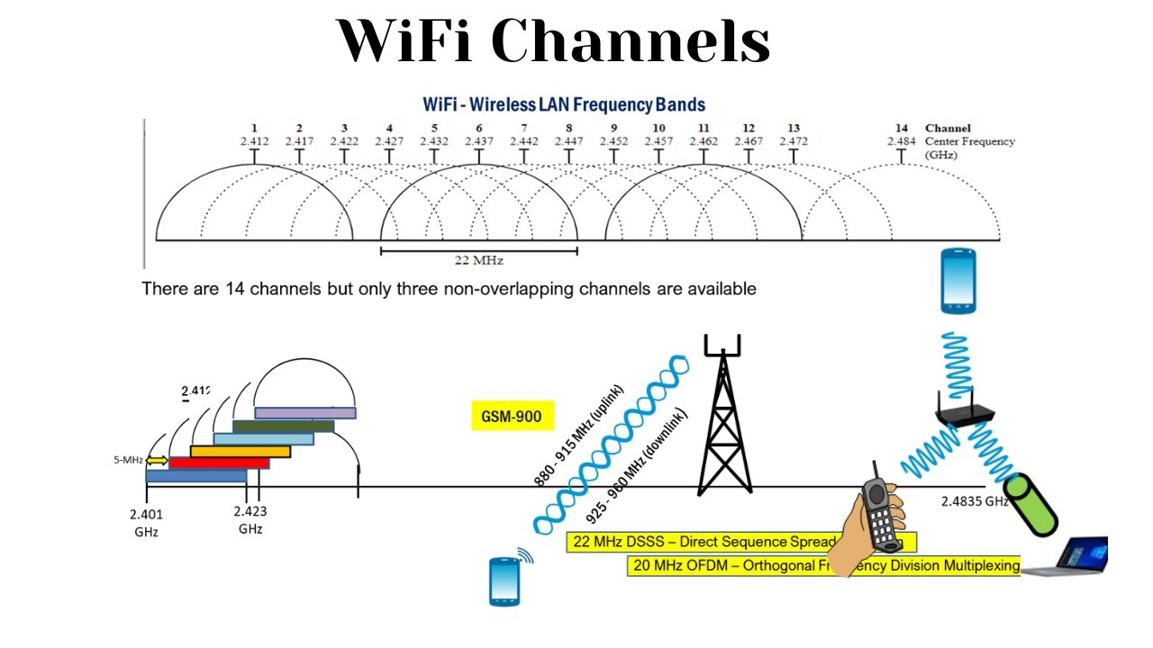
802.11: Channels

Slide 110
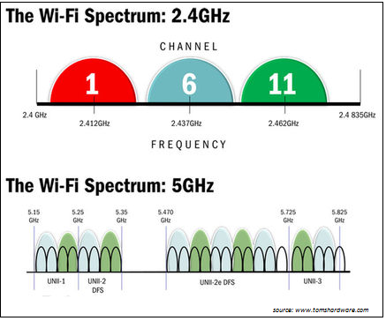
802.11: Channels
OFDM Channels

Slide 111
